Slide 1
VR AI Art Gallery
Team Members: Rachel Lindquist, Nishidha Koneru, Scott Hunt
Advisor: Prof. John Gallagher

Slide 2
Goals
1. To learn about machine learning interactions with VR while using existing knowledge about programming and AI algorithms
2. To gain experience in new tools and technologies, such as Unity and AI-generated imagery
3. To create a VR application that allows people to safely tour an AI art museum with low risk of motion sickness
4. To present a functional VR application at the UC CEAS Expo

Slide 3
Intellectual Merits and Broader Impacts
Intellectual Merits:
VR Technology:
Our project allowed us to learn more about development and deploying and testing in non-traditional environments.
AI Technology:
Our project allowed us to learn more about AI technology and how AI works and is able to create.
Broader Impacts:
Our project showcases a newer form of art, AI generated art - AI art in VR - which will slowly become more mainstream and may even begin showing up in traditional art galleries. This project also allows users to explore an art gallery from the comfort of their own home while in a provided virtual space.

Slide 4
Design Specifications (High Level Overview)
Inputs a prompt
Generates art using AI
Display AI generated art
user

Slide 5
Design Specifications (Mid Level Overview)
Pick theme from list
AI generates images with theme in mind
Unity displays images
Code passes input to AI
user
User walks around gallery, able to view generated images
Does user want to create new images?
no
Stop
yes

Slide 6
Design Specifications (Lower Level Overview)
Input list is displayed as a drop down UI element
Unity is passed input choice
Unity transfers choice to python code
User picks from input list
user
AI chooses image generating technique that best fits input
User walks around / views gallery
Does user want to create new images?
no
Stop
AI creates image
AI art is displayed in Unity
yes

Slide 7
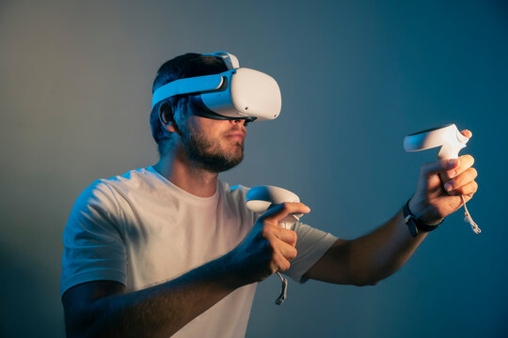



Technologies Used
Meta (Oculus) Quest 2:
VR Headset
Unity3D:
Handles all front end/rendering/graphical interfaces for the project
Handles VR tracking and movement
Stable Diffusion:
Python library used to generate AI art

Slide 8
Milestones and Deliverables
Milestones:
Integration for Windows: 02/1/23
VR Tracking and Movement: 2/15/23
Basic Python AI Image Generation: 2/26/23
Completed Gallery: 3/6/23
Completed Python AI Image Generation: 3/7/23
Deliverables:
Health and Safety Document: 1/18/23
User Docs: 2/07/23
Copyright Document: 3/20/23
Demo: 3/6/23
Completed Project: 4/6/23

Slide 9
Current Results and Future Tasks
Results:
We have a working integrated demo which can display generated images.
We have completed the deliverables currently assigned by the class as well as health and safety information specific to VR and copyright information.
Tasks we still need to complete:
We still need to improve the gallery and image creation as well as complete full testing.
We also still need to work on packaging and building of the final product.

Slide 10
Largest Challenge
Integration
Because Unity makes use of C#, we had to add in integration between the Unity C# code and our image generation Python code. Our code makes use of Python.NET which allows us to run Python code as a library through C#. This should theoretically allow us to build for both Windows and Android.

